Slide 1
A Standard Design Language for Autonomous Networks
Paul Harvey
paul-harvey.org

Slide 2
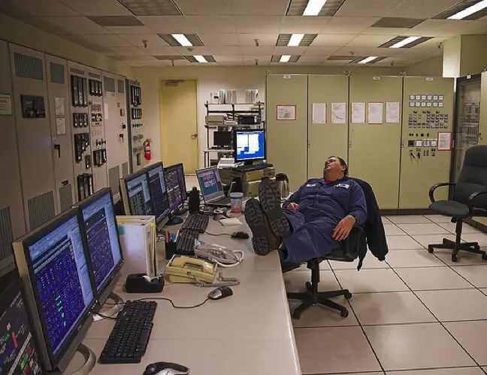
The Dream
Peter Baer

Slide 3

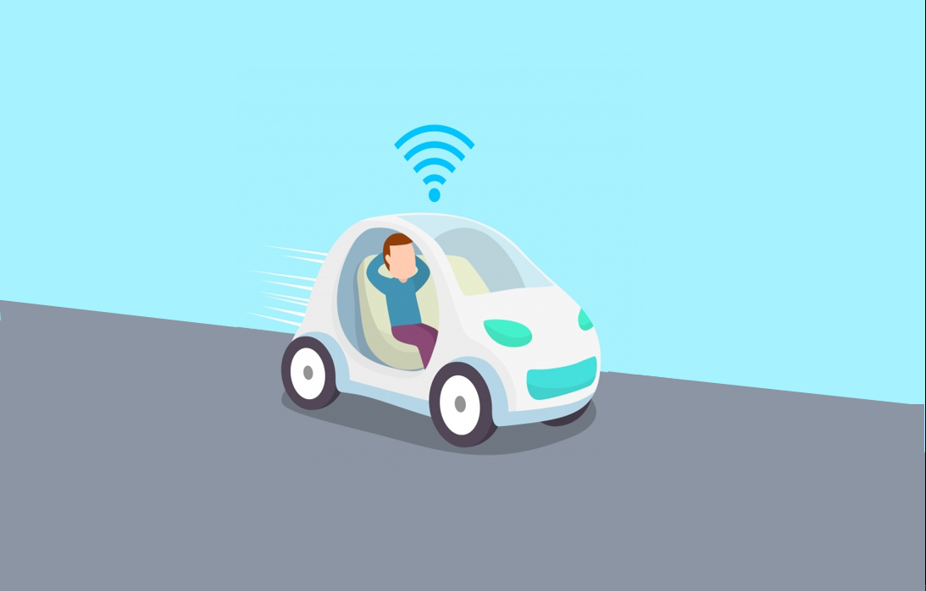

Slide 4
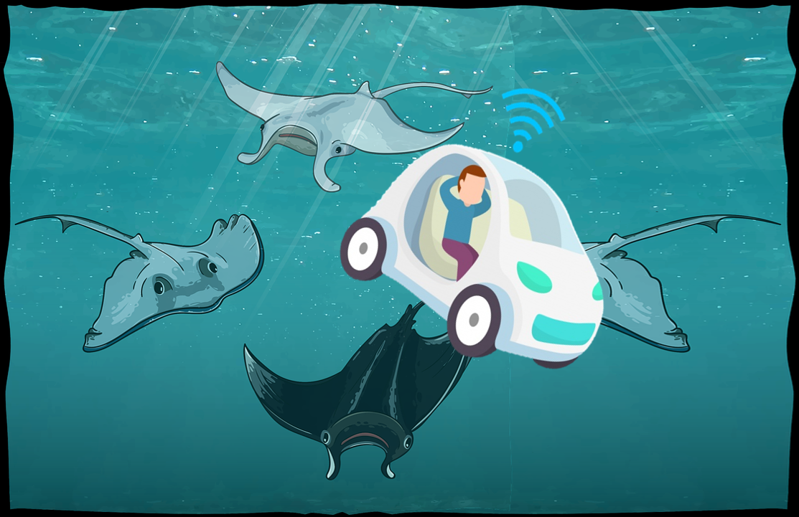

Slide 5



Slide 6


100 Years Later…
https://tech.co/news/steets-littered-adult-pokemon-go-players-2016-07
https://www.sadanduseless.com/evil-iphones/
Notes:
https://tech.co/news/steets-littered-adult-pokemon-go-players-2016-07
https://www.sadanduseless.com/evil-iphones/

Slide 7
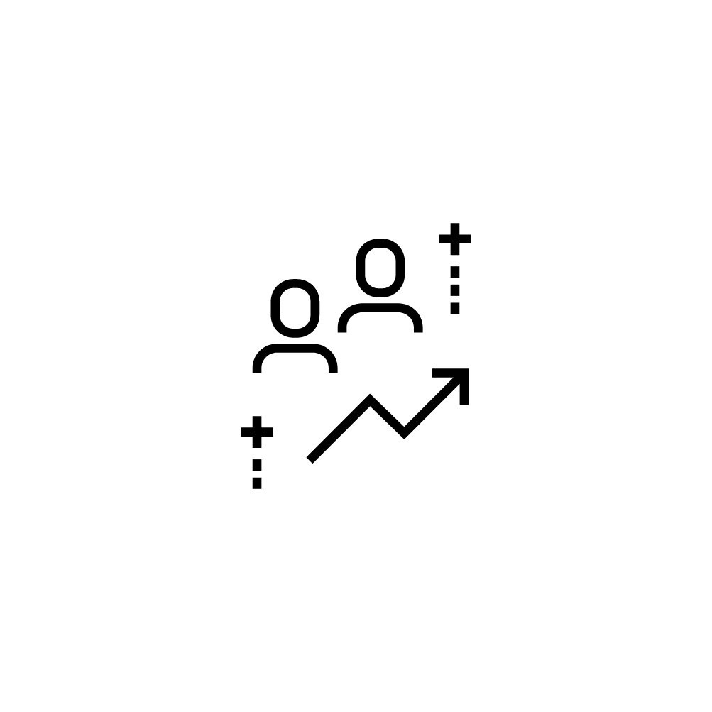




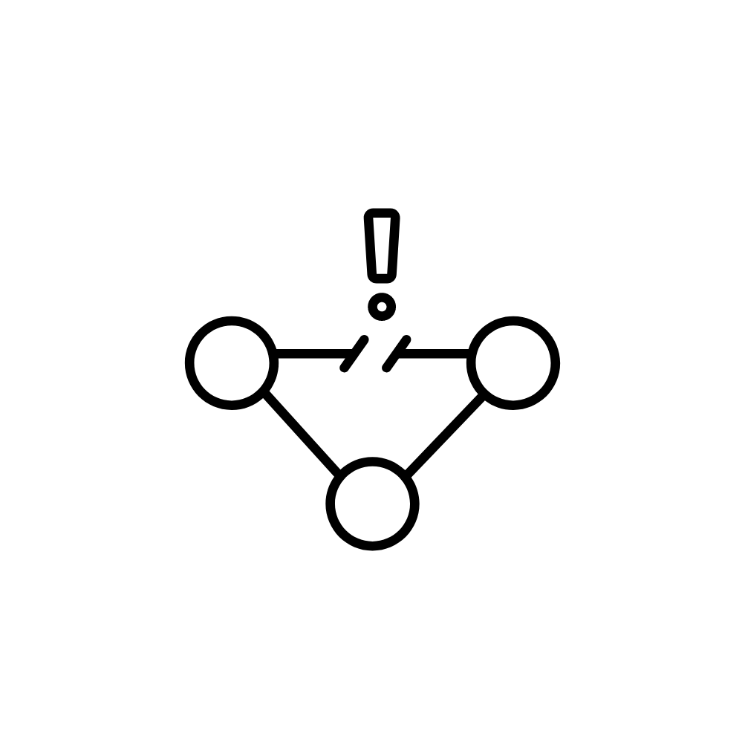




External Demand
Internal Demand
Reduce OPEX
More Users
Decreasing Fees
Save Power
High Coverage
Network
Engineers
Fix Faults
New Communication Types
Increase Throughput

Slide 8
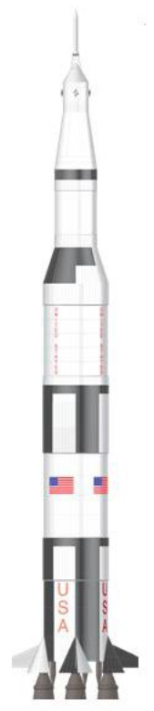
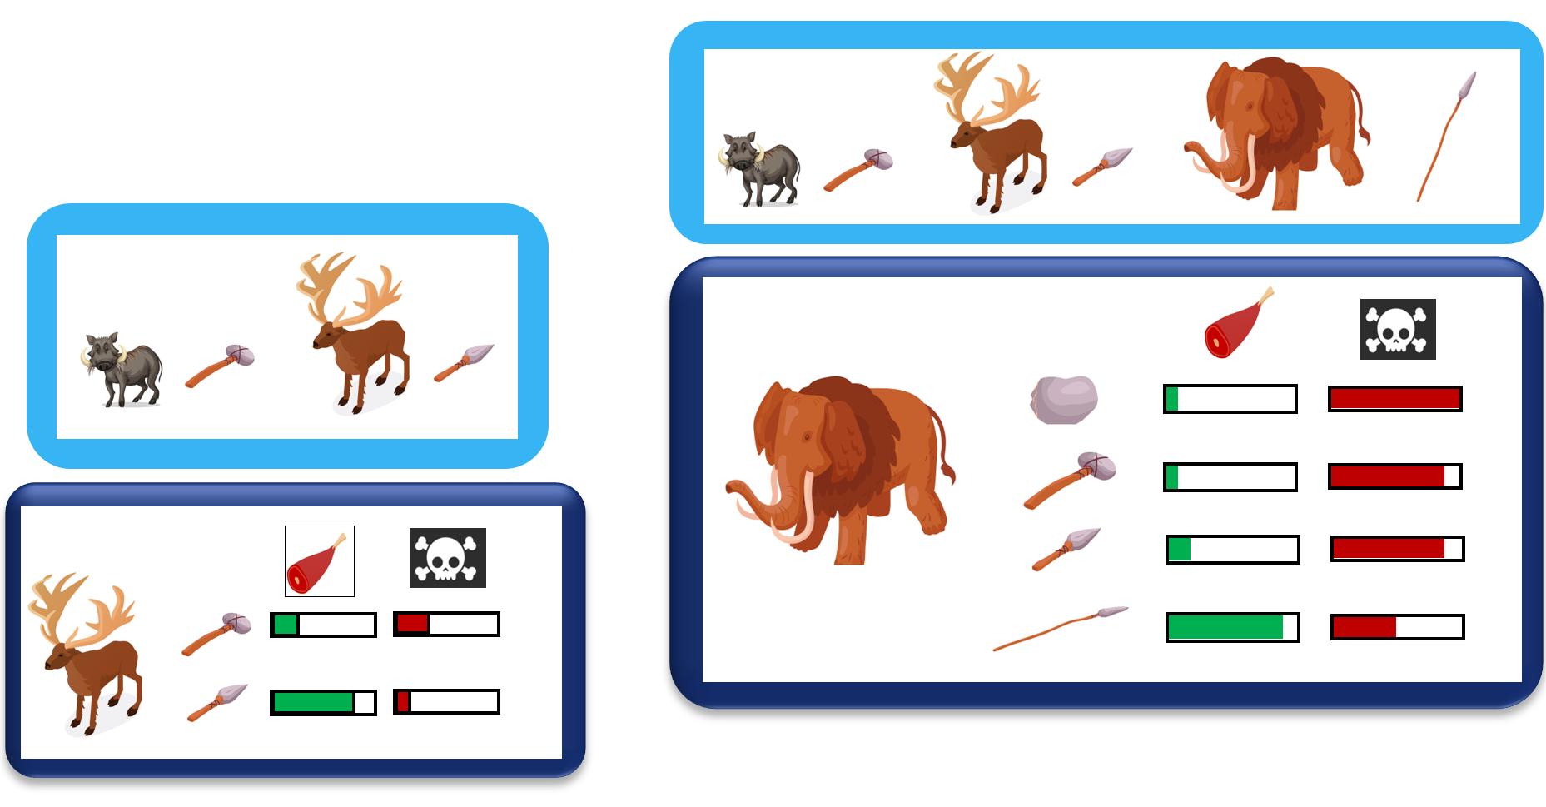
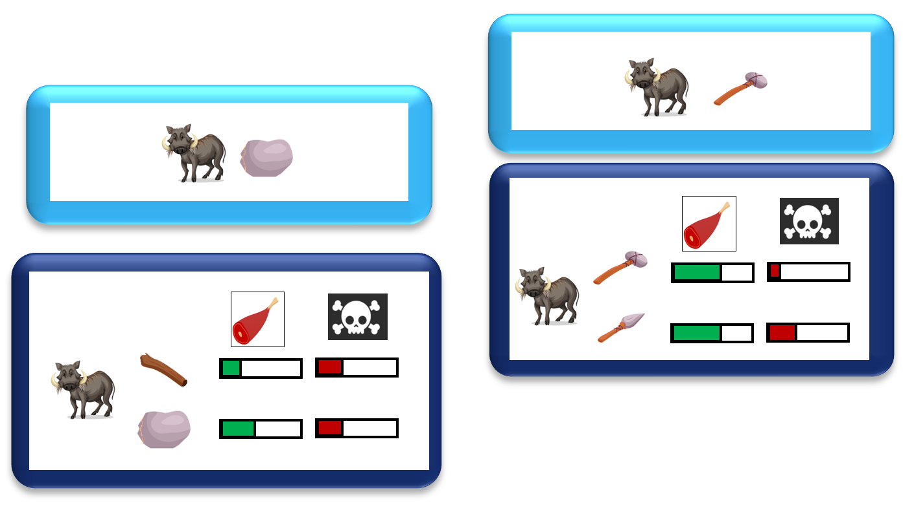
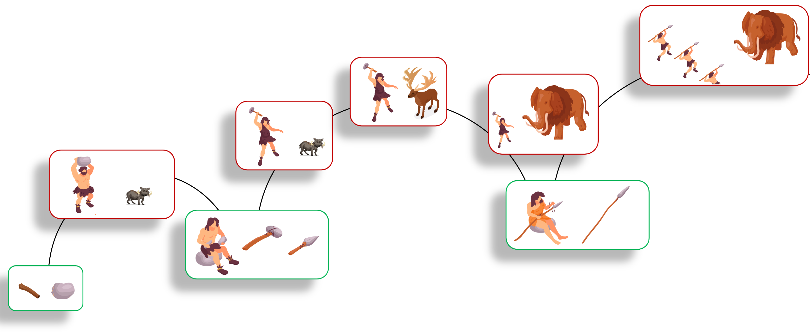
How to adapt to the unknown
Acquire
Knowledge
Analyse
Results
Unknown Opportunity
Unknown threat
Experiment
Discover
Create
Invent new approach
recompose
Improve tool
recompose

Slide 9
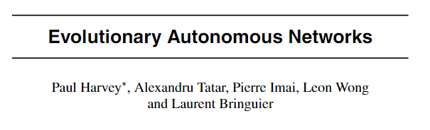
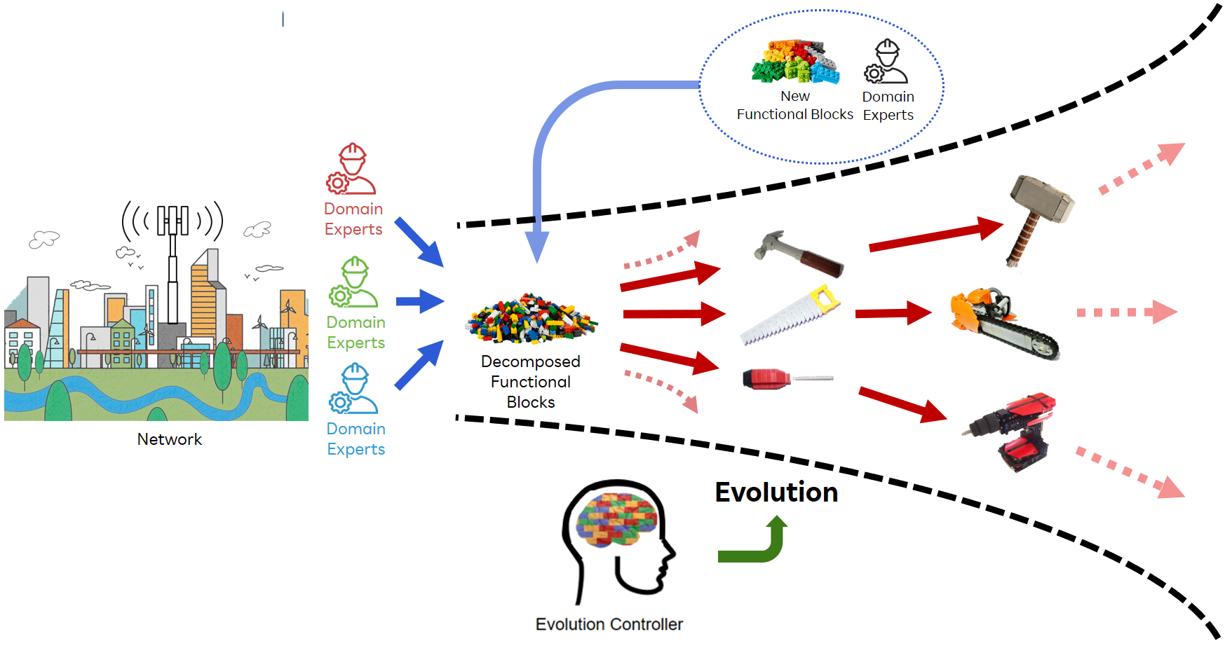

Slide 10
Create Logic
Validate Logic
Apply Logic

Slide 11
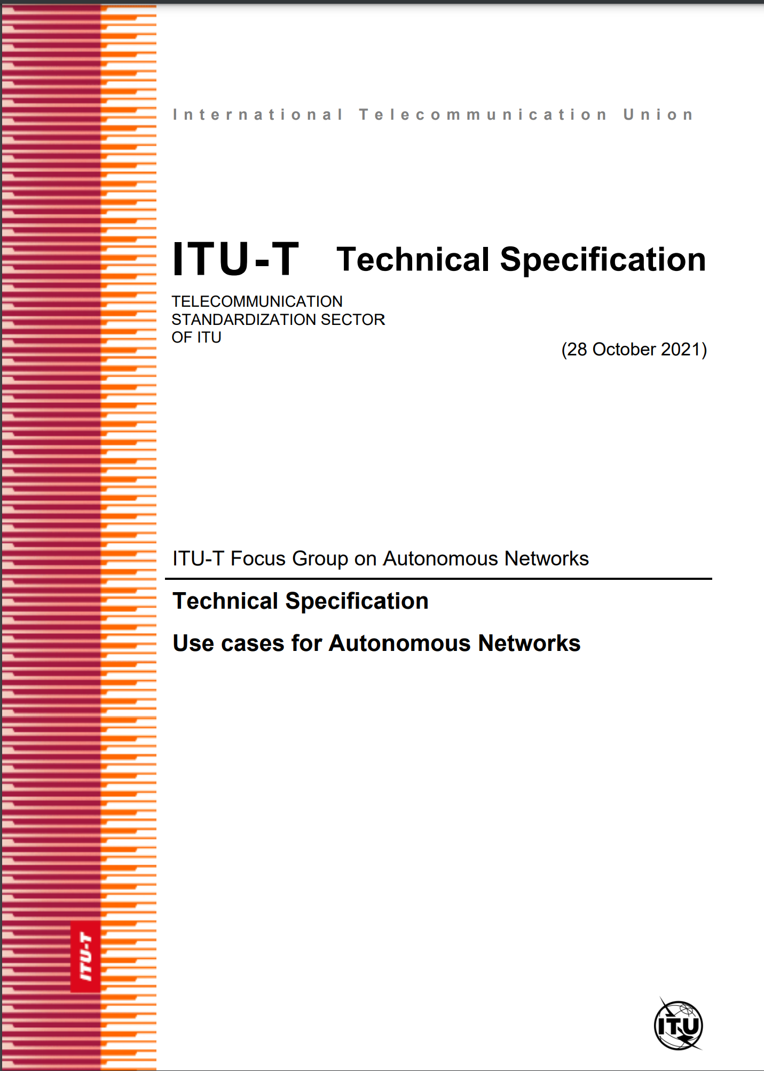

Process
138 Requirements
3 Key Concepts
Architecture
Architectural components
Architectural Framework
ITU-T Y.3061

Slide 12
Requirements
Requirements for Exploratory Evolution
Requirements for Online Experimentation
Requirements for Dynamic Adaptation
Requirements for Knowledge
Requirements for Autonomous Network Orchestration

Slide 13



Controller
Controller

Slide 14
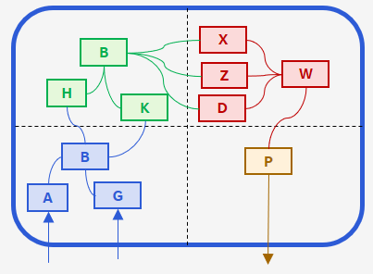
Definition 3.2.4: Controller
A workflow, open loop or closed loop of a system under control in an autonomous network, composed of modules, integrated in a specific sequence, using interfaces exposed by the modules, to solve a specific problem or satisfy a given requirement.
Controller

Slide 15
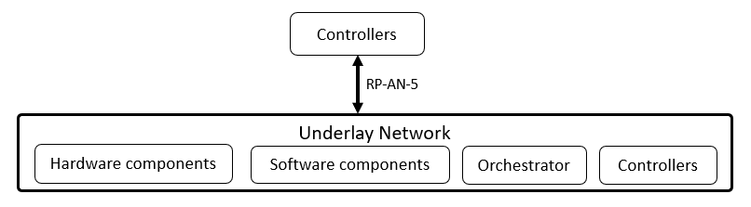
The interactions are:
Controller interacting with hardware components.
Controller interacting with software components.
Controller interacting with an orchestrator or other software control mechanisms.
Controller interacting with other controllers.
NOTE 4 - Building upon this simple representation, hierarchies of controllers may be formed.

Slide 16

Exploratory Evolution
Exploratory evolution exploratory evolution introduces the mechanisms and processes of exploration and evolution to adapt controllers in response to changes in the underlay network.
NOTE 1 - An example of a process that creates a controller is the composition of controllers from modules or other closed loops. This may involve the selection of modules which are used for composition.
NOTE 2 - An example of a process that modifies an existing controller is the dynamic change in the controller’s structure by adding new modules, deleting existing modules, replacing existing modules, or rearranging the structure of a controller’s modules, in accordance with the real time changes in the system under control.
Controller
Exploratory Evolution
Controller
Controller

Slide 17
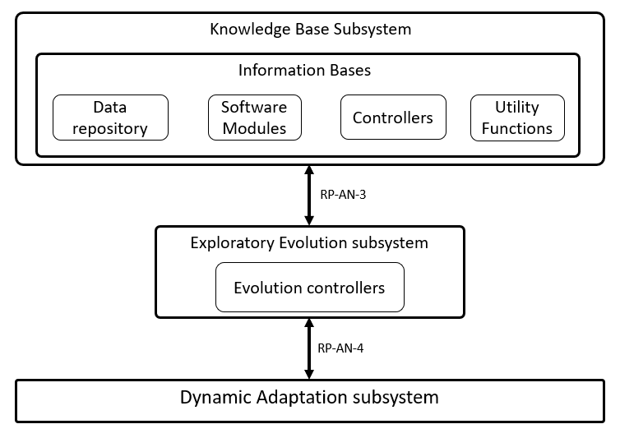
Exploratory Evolution
3.2.7 Evolution controller: A controller responsible for the evolution of controllers by manipulating the module instance used within a controller, the structure or topology of connections between modules in a controller and/or the values chosen for the module(s) parameters
Examples of processes to drive the modification of a controller are:
biologically inspired artificial evolution(e.g evolutionary computing or genetic programming [b-large-evolution, b-evolution])
Bayesian optimisation [b-bayesian-radio]
game theoretic approaches [b-game-theory].

Slide 18
Examples of Controller Evolution
1) A “RAN channel scheduling controller” is an example of a controller used to allocate radio resources to users in a multi-user environment. Exploratory evolution is applied to a RAN channel scheduling controller in response to the change of radio channel feedback from the UE. This may include selecting the most appropriate algorithm from a set of alternatives.
2) An “anomaly detection controller” is an example of a controller used to detect abnormal states in the operation of a network service, such as security attacks or peaks in resource usage for network function. In this context, the new approaches of data fusion algorithms [b-data-fusion] may be applied. Exploratory evolution is applied to “anomaly detection controller” by optionally using and configuring newly provided data fusion algorithms as the input of an “anomaly detection controller”,
3) A “time-to-live controller” is an example of a controller used to configure the time duration for which a certain content is cached in a CDN server. In a time-to-live controller in a caching system at the edge, optimisation of the timeout parameter(s) is an example of application of exploratory evolution.
4) A “scaling controller” is an example of a controller used to increase or decrease the resource allocation for a network function. In this context, exploratory evolution may be applied by controlling the configuration of the scaling method of deployed controllers in a specific network domain.

Slide 19
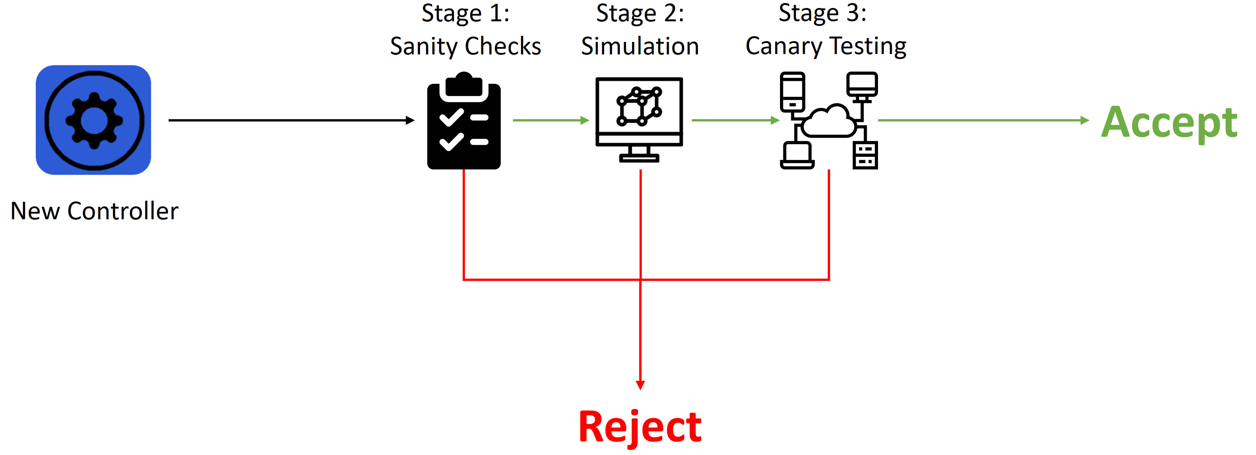
Realtime Online Experimentation
3.2.8 Experimentation: The process of executing the generated potential scenarios and trials upon the controllers, within the parameters of the scenarios and trials and then collecting the results.
Controller

Slide 20
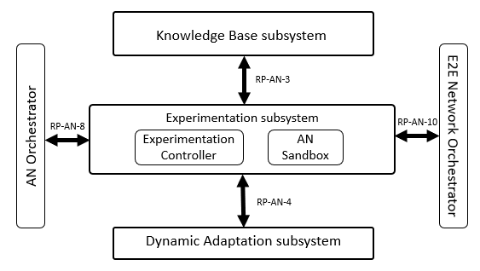
Realtime Online Experimentation
3.2.9 experimentation controller: A controller which generates potential scenarios of experimentations based on controller specifications and additional information as provided by the knowledge base, executes the scenarios in the AN Sandbox, collates and validates the results of the experimentation.

Slide 21
Examples of Controller Experimentation
Examples of experimentation in various application contexts are given below:
The use of static “sanity checking” such as formal methods [ITU-T Y.3320] or model checking to ensure that provided management and orchestration solutions are well-formed against pre-defined rules
The use of simulators or digital twins in offline validation of controllers. These simulators or digital twins can support the same interfaces as underlays.
The use of digital twins [b-Digital-twin] in online validation of controllers before deployment
NOTE 5 - online validation involves use of timescales comparable to real underlays e.g. validation of controllers (xApps) [b-ORAN] using digital twins.
Combinations of the above to achieve broader coverage of validation, from the offline validation to online validations during the operation of the underlay.

Slide 22
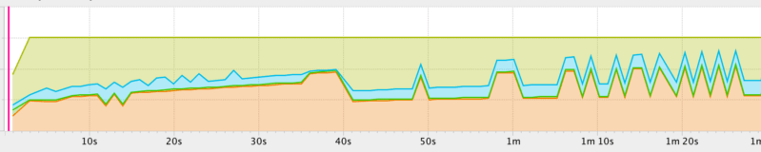
Dynamic Adaptation
Dynamic adaptation is the process of continuous integration of controllers to an underlay, as the underlay undergoes changes at run-time. Integration of controllers may involve multiple domains of the underlay.
Controller
Controller
Controller

Slide 23
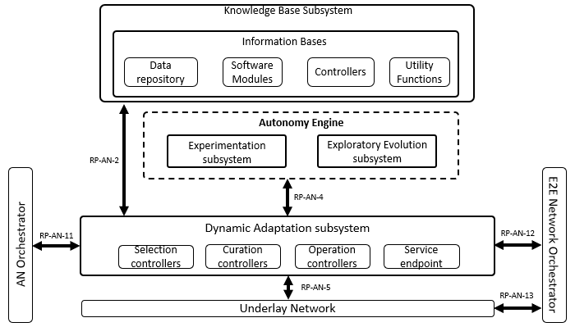
Dynamic Adaptation
3.2.1 adaptation controller: A controller responsible for selecting candidate controllers ready for integration and for executing their integration in the underlay network.
Adaptation controller has two parts:
Curation controller (responsible for selection and maintenance of the controllers within the curated controller lists from the evolvable controllers) and
Selection Controller (responsible for the selection of a services’ operational controller from the curated controller lists).

Slide 24
Examples of Dynamic Adaptation
Examples of adaptation in various application contexts are given below:
The need to use different traffic shaping algorithms for various geographical contexts, such as urban vs rural
Business priorities may change over a period of time, e.g. prioritization of performance KPIs over energy efficiency or prioritisation of internal applications over third party applications. These changes in business priorities may necessitate the use of different virtual machine or container scheduling controllers.
There could be a need to deploy new technology in order to improve or optimise operation, including adding new capabilities that previously did not exist. E.g. new AI/ML algorithms or new data fusion approaches to blend the increasing number of data sources.
There could be a need to deploy new technology in order to address errors or faults. E.g. data acquisition or actuation software for new hardware devices or adaptation software to account for incompatibilities in deployed technology.

Slide 25
Architecture Components
Evolution Controller
Knowledge Base
AN Orchestrator
Creates and modifies a controller in accordance with the system under control and the real-time changes therein.
Manages knowledge derived from and used in autonomous networks. It is updated and accessed by various components in the autonomous network.
managing workflows and processes in the AN and steps in the lifecycle of controllers
Experimentation Controller
An Sandbox
Adaptation Controller
Validates controllers using inputs from a combination of underlay network, simulators and/or testbeds.
environment in which controllers can be deployed, experimentally validated with the help of (domain specific) models of underlays
Continuous integration of controllers to an underlay, as the underlay undergoes changes at run-time.

Slide 26
Architecture Components
FGAN-I-345-R2
Evolution Controller
Knowledge Base
AN Orchestrator
Creates and modifies a controller in accordance with the system under control and the real-time changes therein.
Manages knowledge derived from and used in autonomous networks. It is updated and accessed by various components in the autonomous network.
managing workflows and processes in the AN and steps in the lifecycle of controllers
Experimentation Controller
An Sandbox
Adaptation Controller
Validates controllers using inputs from a combination of underlay network, simulators and/or testbeds.
environment in which controllers can be deployed, experimentally validated with the help of (domain specific) models of underlays
Continuous integration of controllers to an underlay, as the underlay undergoes changes at run-time.

Slide 27
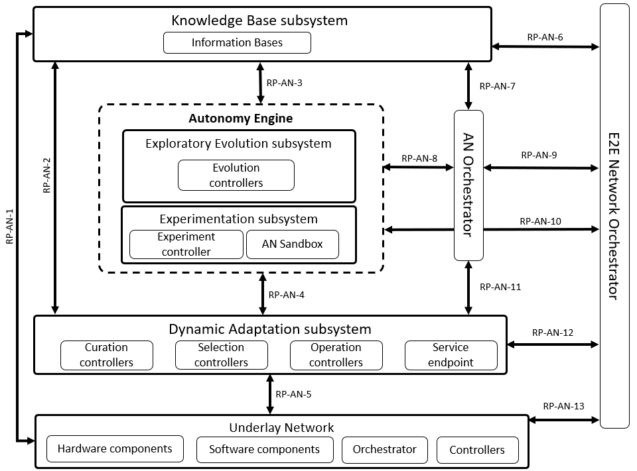

Slide 28
3 Key Concepts

Slide 29
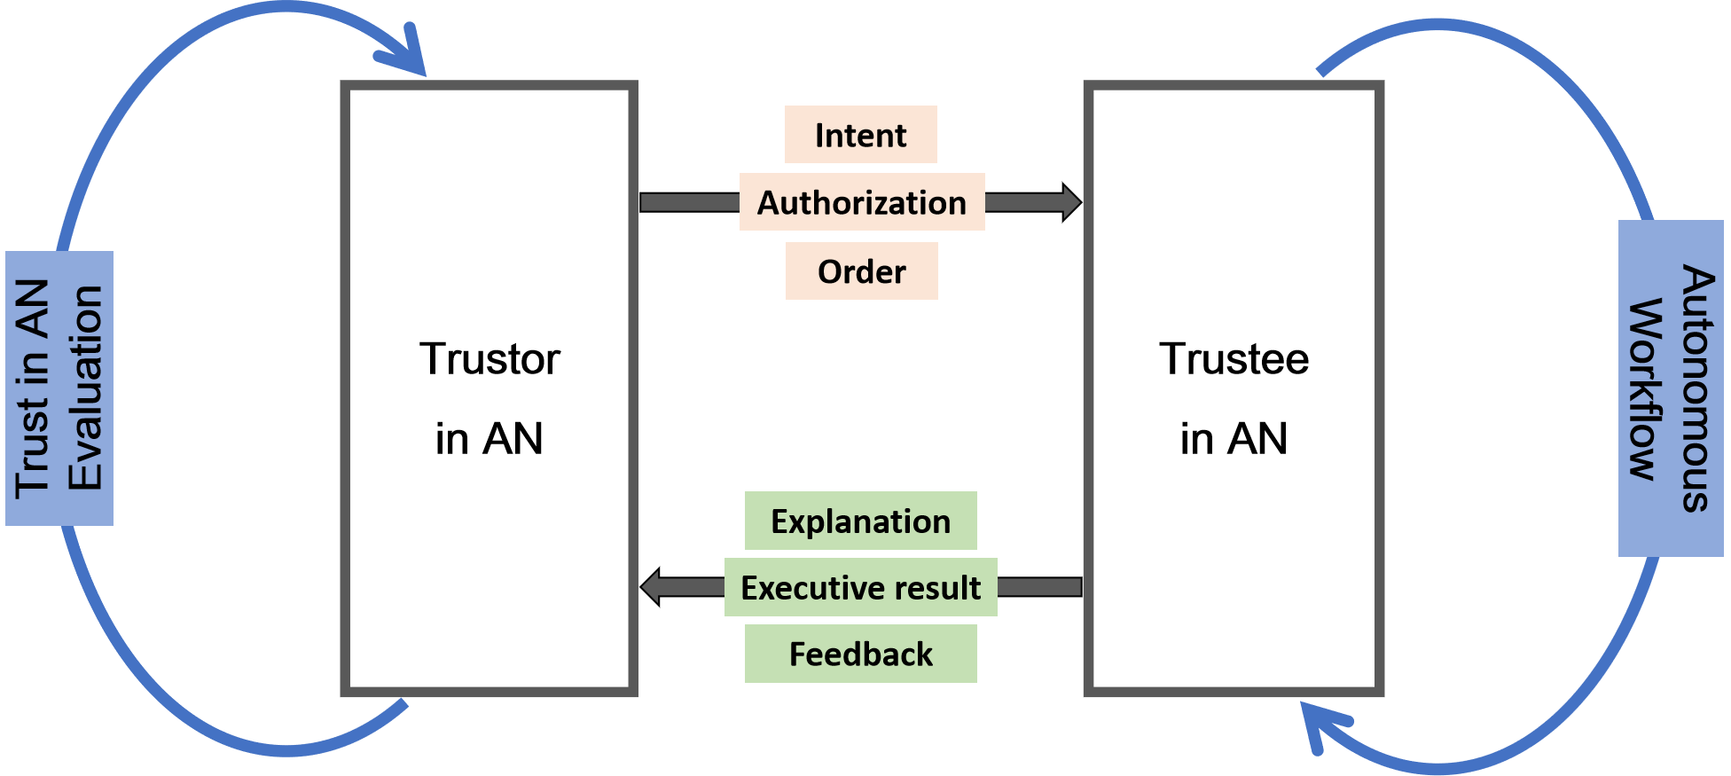
“Trust in Autonomous Networks” - https://extranet.itu.int/sites/itu-t/focusgroups/an/input/FGAN-I-094.docx

Slide 30
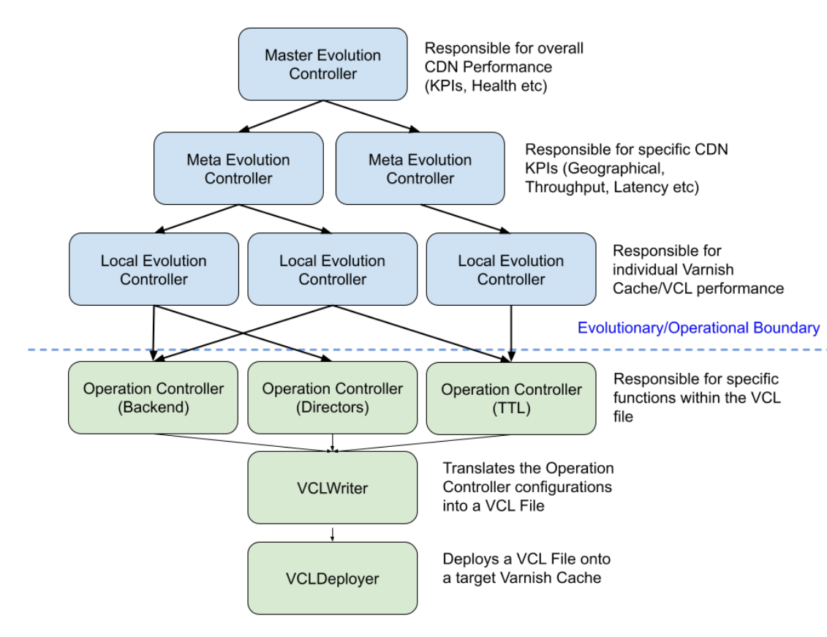
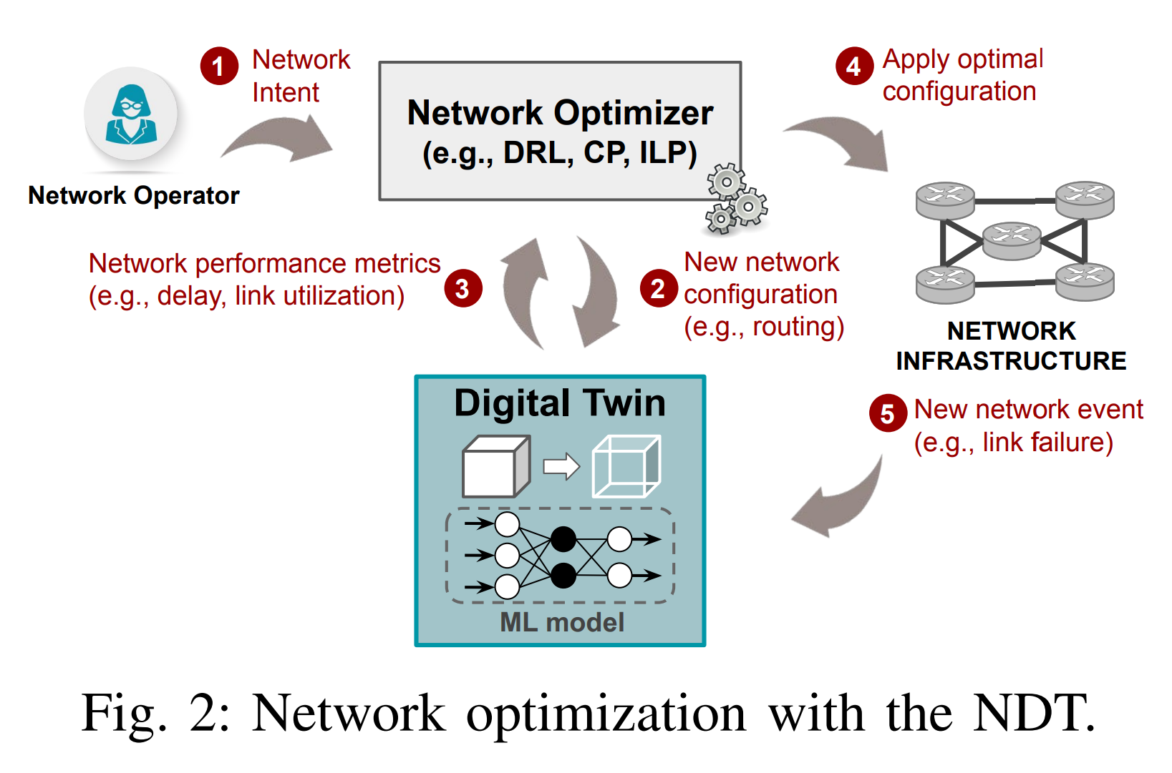






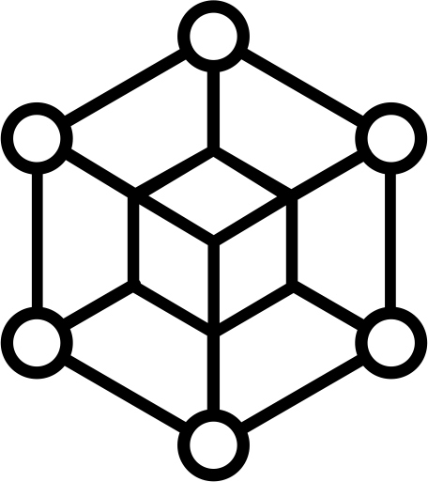
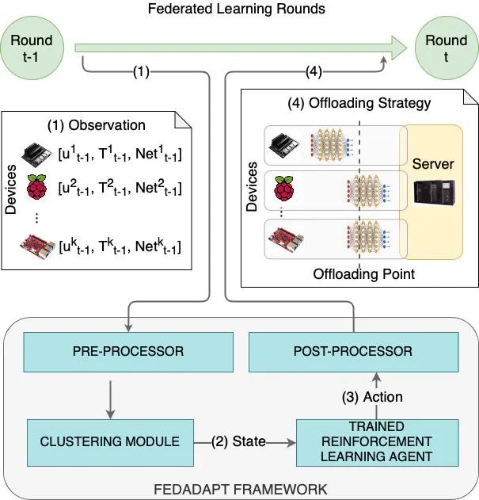
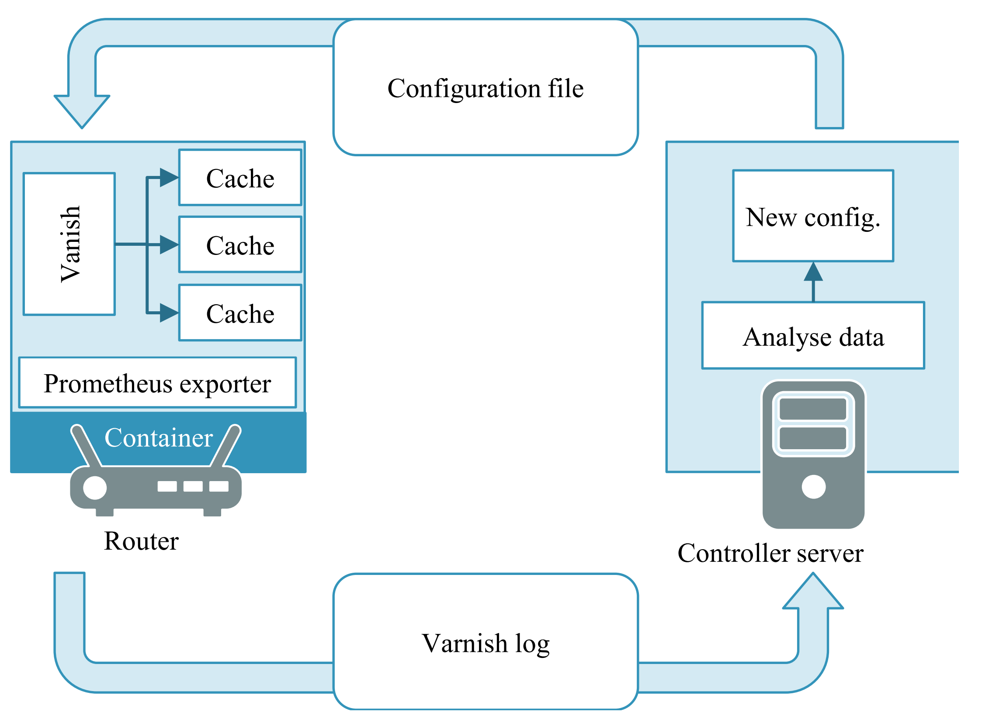
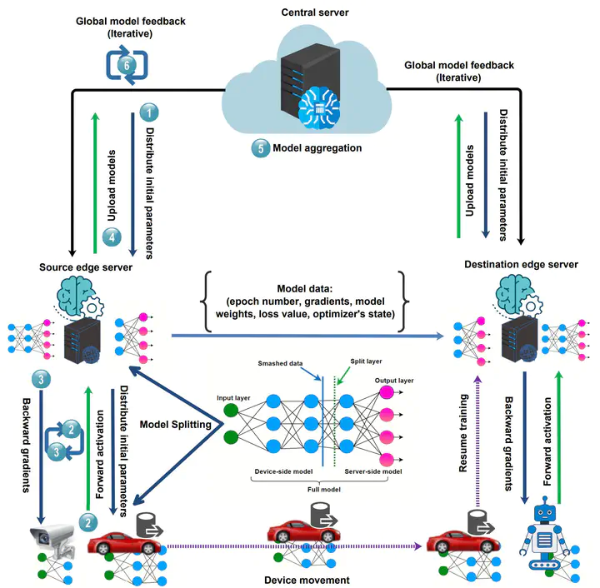
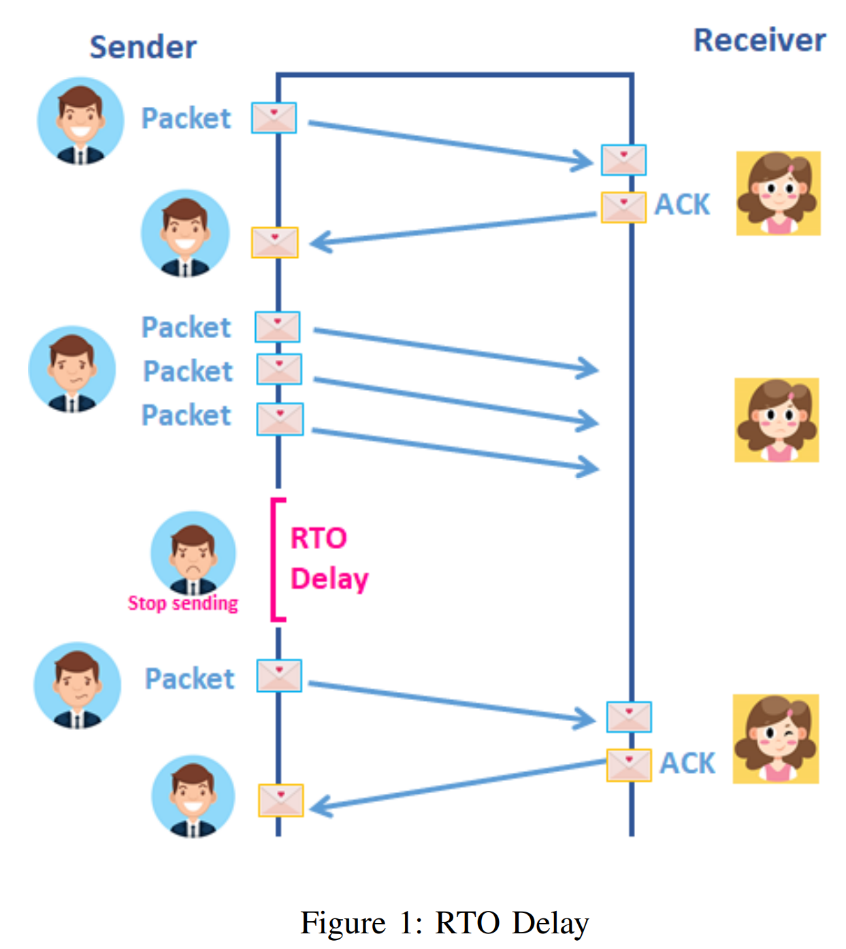
Evolutionary Autonomous Networks
Blockchain Marketplace For Autonomous Networks
4
1
5
Network Digital Twin: Context, Enabling Technologies and Opportunities
2
3
Towards evolution-based autonomy in large-scale systems.
Create
Validate
ETHEREUM
Apply
FedFly: Towards Migration in Edge-based Distributed Federated Learning
Herding the FLOQ: Flow Optimised Queueing
FedAdapt: Adaptive Offloading for IoT Devices in Federated Learning
A Feasibility Study of Cache in Smart Edge Router
for Web-Access Accelerator

Slide 31
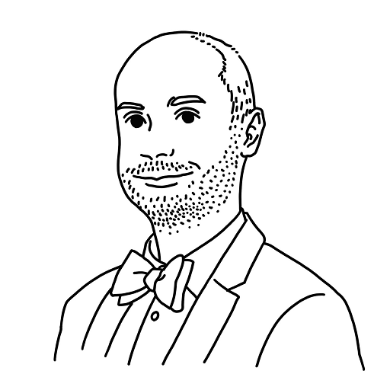

Create Logic
Validate Logic
Evolutionary Computing
Fitness Function Decomposition
Ontology Guided Creation
Meta-evolution
Automated Code Synthesis
Digital Twin
Formal Verification
Co-simulation
Experimental Design
Chaos Testing
Apply Logic
Aid Logic
www.paul-harvey.org
@jhebus
Resource Allocation Problems
Parallelisation
Virtualisation
Information Centric Networking
Telco Cloud / O-RAN
Ontology & Taxonomy Generation
Levels of Autonomy
Intent-Based Systems/Networks
Explainable Operation

